Slide 1


An improved histogram equalization
method in the traffic monitoring image
processing field
Author：JiaShi
Computer Science and Technology
Wuhan University of Technology
2015.11.22

Slide 2

1
Background of this problem
2
Traditional Histogram Equalization
3
Three feather of traffic monitor image process
4
Our method
5
Comparison of several algorithms

Slide 3
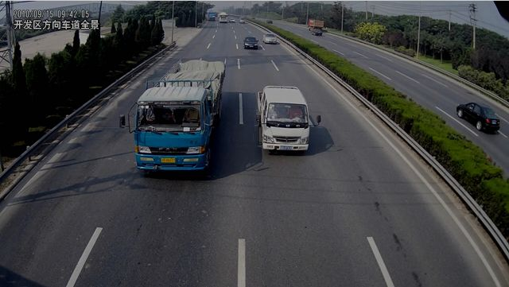
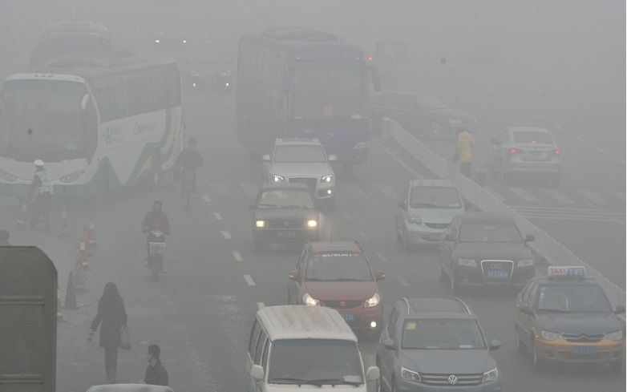
Background of this problem
With the rapid development of IoT (Internet of thing), traffic monitoring technology has been more and more widely used. But due to various reasons, the traffic monitoring image can not be applied directly. Among them, the device, environments, and the intensity of light are all the factors that influence the image quality. In order to make secondary use, we have to process the image and enhance the image contrast.
(a) dawn image (b) fog image

Slide 4
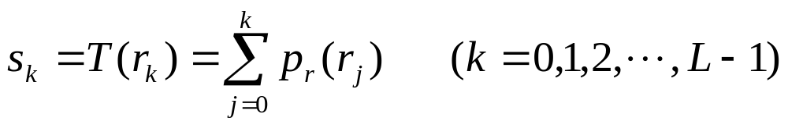
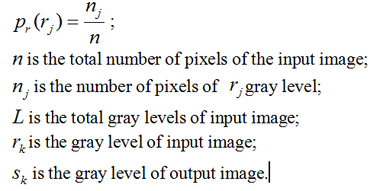
Traditional Histogram Equalization
The discrete transformation function:
Where:
返回

Slide 5
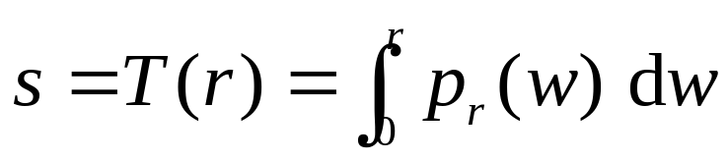
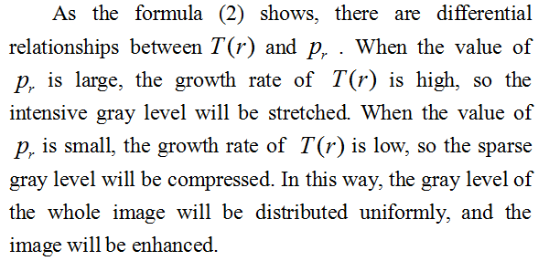
The continuous form of transformation function:

Slide 6
Three feather of traffic monitor image process
A. Most parts of the image are black because of the asphalt pavement. Therefore, it is necessary to prevent the bleaching phenomenon of the processed image.
B. In order to ensure the time efficiency, the proposed method should not be too complex.
C. In order to ensure the method to be processed automatically, it should not have too many arguments.

Slide 7
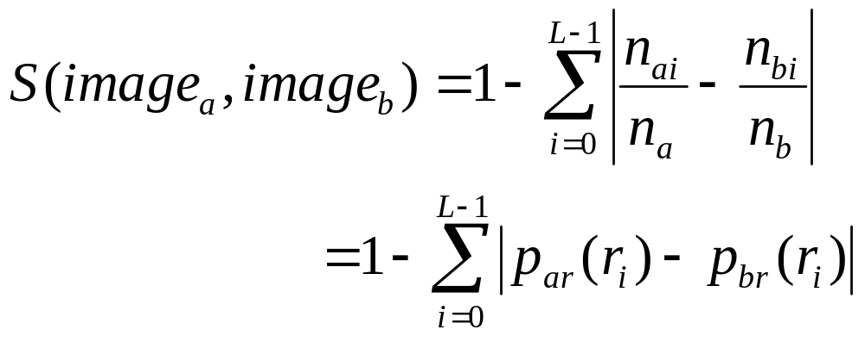
Our method
A. Similarity function
We use the difference of the pixels amount of the same gray level between two sub-block images to measure the similarity degree of them.The similarity degree varies between 0 and 1.Especially, when the two sub-block images are the same, the similarity degree is 1.

Slide 8
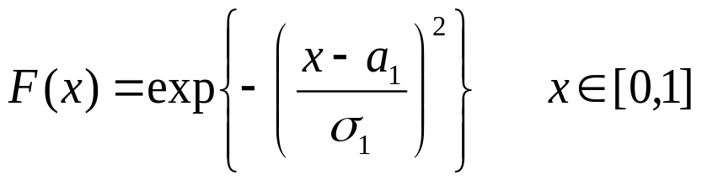
B. calculation of influential factor matrix
The domain of the similarity degree is defined as. Fuzzy set A represents “low-influence degree” and the influential factor is 1/16; Fuzzy set B represents “mid-influence degree” and the influential factor is 1/8; Fuzzy set C represents “high-influence degree” and the influential factor is 1/4. Because only when the similarity degree is suitable, the value of the influence degree can be maximum. Therefore, Fuzzy distribution function of the intermediate type should be assigned as the membership function. In this paper, we choose gaussian function as the membership function of Fuzzy set A, B and C.

Slide 9
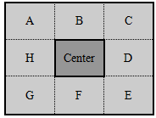
According to the three membership functions and the principle of maximizing membership, the influential factors from the around sub-blocks to the central block is calculated(That is to calculate the influential factors form sub-blocks A,B,C,D,E,F,G,H to the center block), and then the influential factors matrix M_{influence} can be acquired. Because the similarity degree of the center block is 1, the center value of M_{influence} is always 1/4 of "high-influence degree".

Slide 10

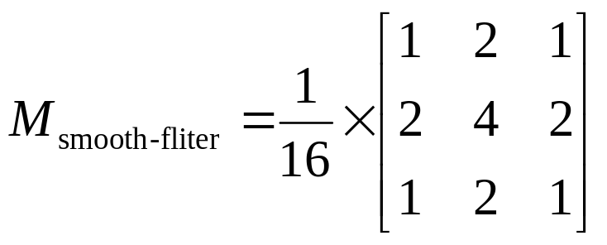

C. combination of smooth-influence matrix
Because we have divided the input image into a series of sub-blocks before the processing,there are some inevitable artificial boundaries in the processed image. In order to decrease the computational complexity and reduce the quantity of artificial boundaries, the smoothing filter matrix is combined with M_{influence} to acquire the final smooth-influence matrix to process the image. In this way, the artificial boundaries will not be processed independently. We define operator to represent the combination of matrix

Slide 11
D.The steps of our method
Step1: Color transformation (RGB->HSV);
Step2: Extract the V component, and divide it into a series of sub-blocks;
Step3:Compute,and get the transformation function of the center block;
Step4: Implement the equalization process of the center block;
Step5: Revert the V component and color transformation (HSV->RGB), then output the image.

Slide 12
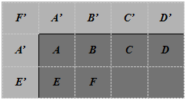
E. Process of edge blocks
For the edge blocks,we copy their reflectional symmetrical blocks as the filled blocks(As the Fig.3 shows, block A and block A', block B and block B' and so on); For the corner blocks, we copy their rotational symmetrical blocks as the filled blocks(As the Fig.3 shows, block F and block F').

Slide 13
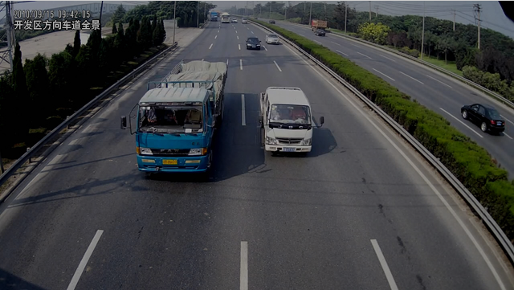
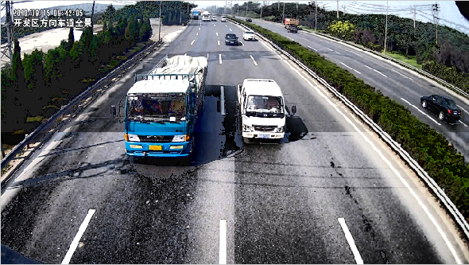
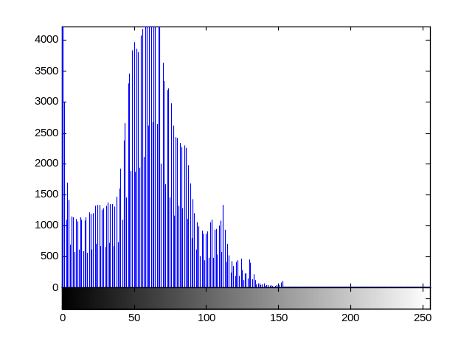
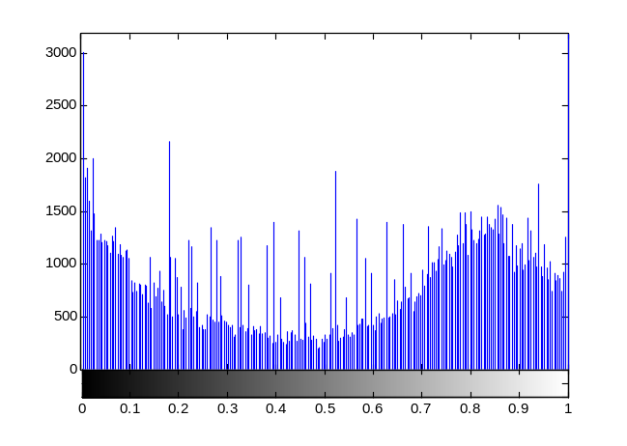
F. Result of our method

Slide 14
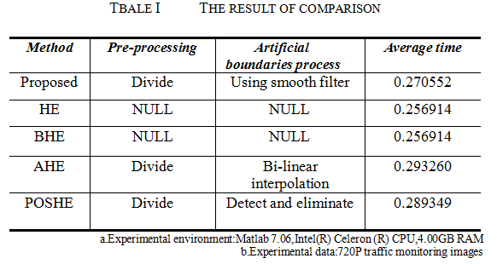
Comparison of several algorithms

Slide 15
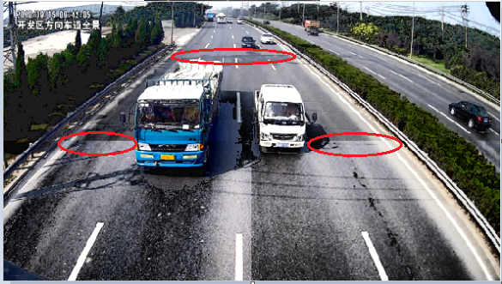
About artificial boundaries
In this paper ,in order to reduce artificial boundaries, we use asmooth filter. But when observed carefully, some slight artificial boundaries will be found. Because the artificial boundaries and the image content are closely related, the method of reducing artificial boundaries completely and quickly is more challenging. So one of the focuses of future research is to eliminate the artificial boundaries.

Slide 16
Thank you
2015.11.22

